Slide 1
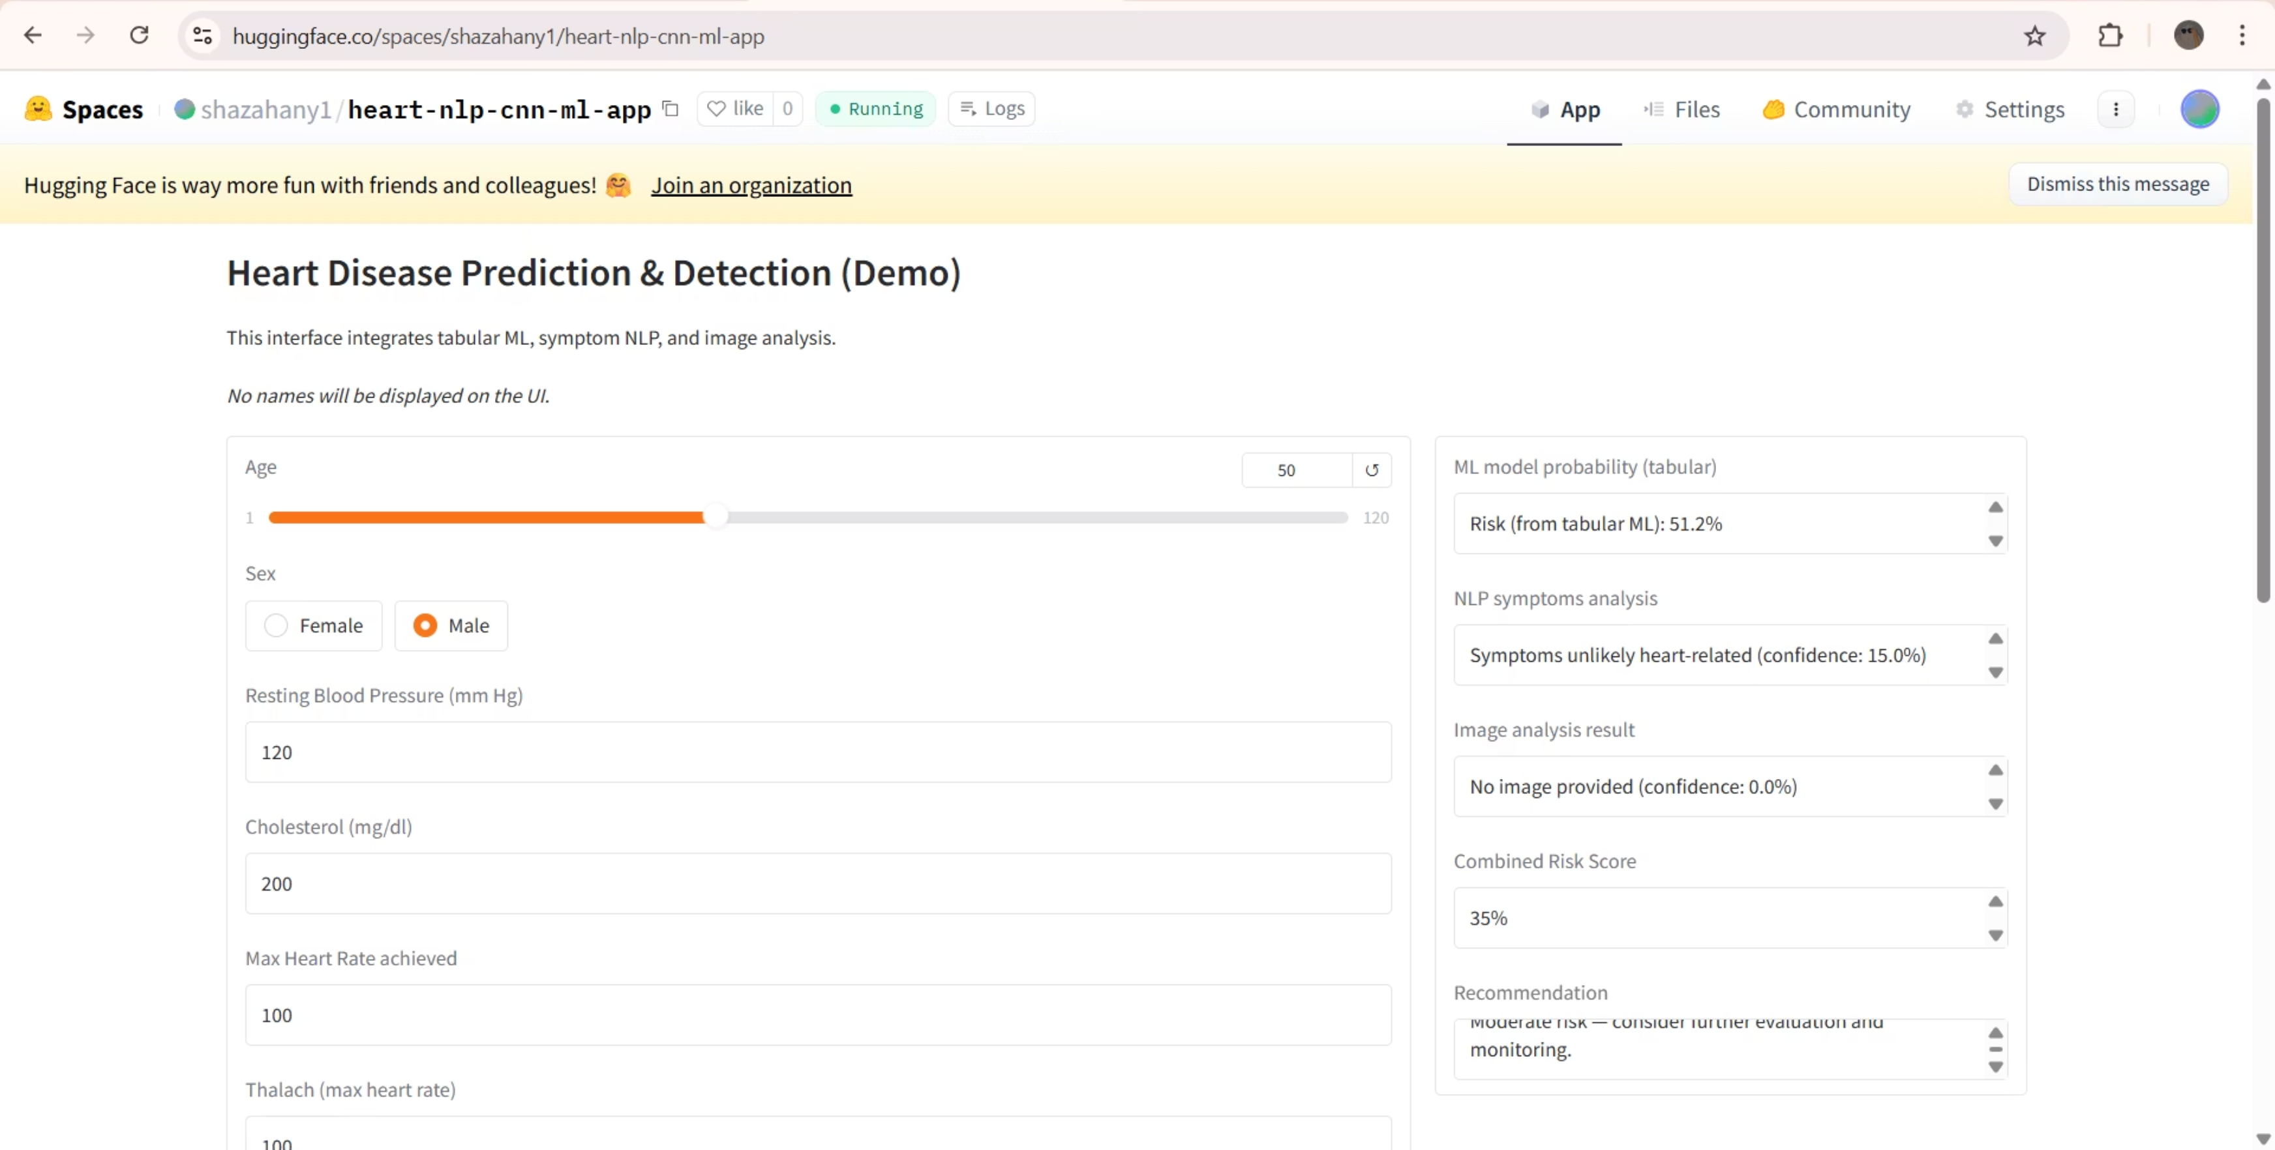
Project Overview: AI-based Heart Disease Prediction & Detection
The goal is to provide a unified, comprehensive assessment of a patient's risk profile, moving beyond single data point analysis to a holistic diagnostic approach.

Slide 2
Integrated AI Modules for Comprehensive Diagnosis
Our proposed system leverages three distinct, specialised AI modules, each targeting a different type of clinical data input, ensuring robust and multi-faceted analysis.
1. Machine Learning (ML) for Tabular Prediction
2. Natural Language Processing (NLP) for Symptom Analysis
3. Computer Vision (CNN) for Image Diagnostics
Focuses on structured patient data (age, blood pressure, cholesterol, etc.) to calculate the probability of CVD exposure.
Analyses free-text patient input (written symptoms like "chest pain" or "shortness of breath") to classify relevance and severity related to cardiac issues.
Processes medical images (ECG, Chest X-rays) using Convolutional Neural Networks (CNN) to detect visual markers of cardiac abnormalities, such as arrhythmia or cardiomegaly.

Slide 3
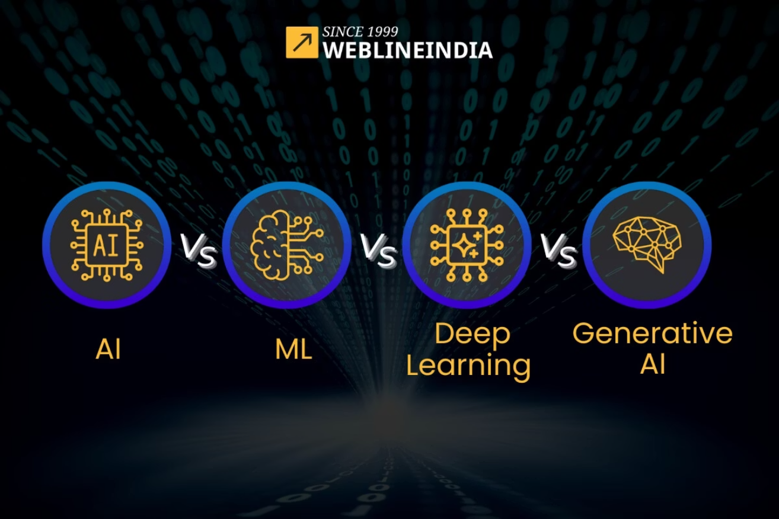
Module Deep Dive: Machine Learning (ML) for Risk Assessment
The core predictive module relies on traditional ML algorithms trained on structured clinical data. This acts as the foundational layer of our risk scoring system.
Data Inputs: Age, sex, blood pressure (rest and maximum), cholesterol levels, heart rate, and existing ECG results (derived features).
Model Selection: We plan to compare and select the best performing model from a set including Logistic Regression (for interpretability), Random Forest, and Extreme Gradient Boosting (XGBoost) for high accuracy.
Objective: Determine a binary outcome (Yes/No) regarding the patient's susceptibility to CVD, based purely on quantifiable medical metrics.
We will use the UCI Heart Disease Dataset for initial training and validation due to its suitability for these model types.

Slide 4




Module Deep Dive: NLP for Symptom Categorisation
Symptom reporting is often subjective. The NLP module standardises this unstructured input, connecting patient complaints directly to potential cardiac risk factors.
Patient Text Input
Text Preprocessing
e.g., "Sharp chest pain and frequent shortness of breath during light exercise."
Tokenisation, lemmatisation, and stopword removal to isolate critical medical terms.
Classification & Scoring
Output
Trained NLP model (e.g., Naive Bayes or fine-tuned BERT) classifies the text as 'Heart-Related Risk' or 'Not Related'.
A boolean result and confidence score indicating whether the symptoms suggest a cardiac concern.
A smaller, custom-built dataset or a curated subset of a general symptom-disease dataset will be utilised for focused training.

Slide 5
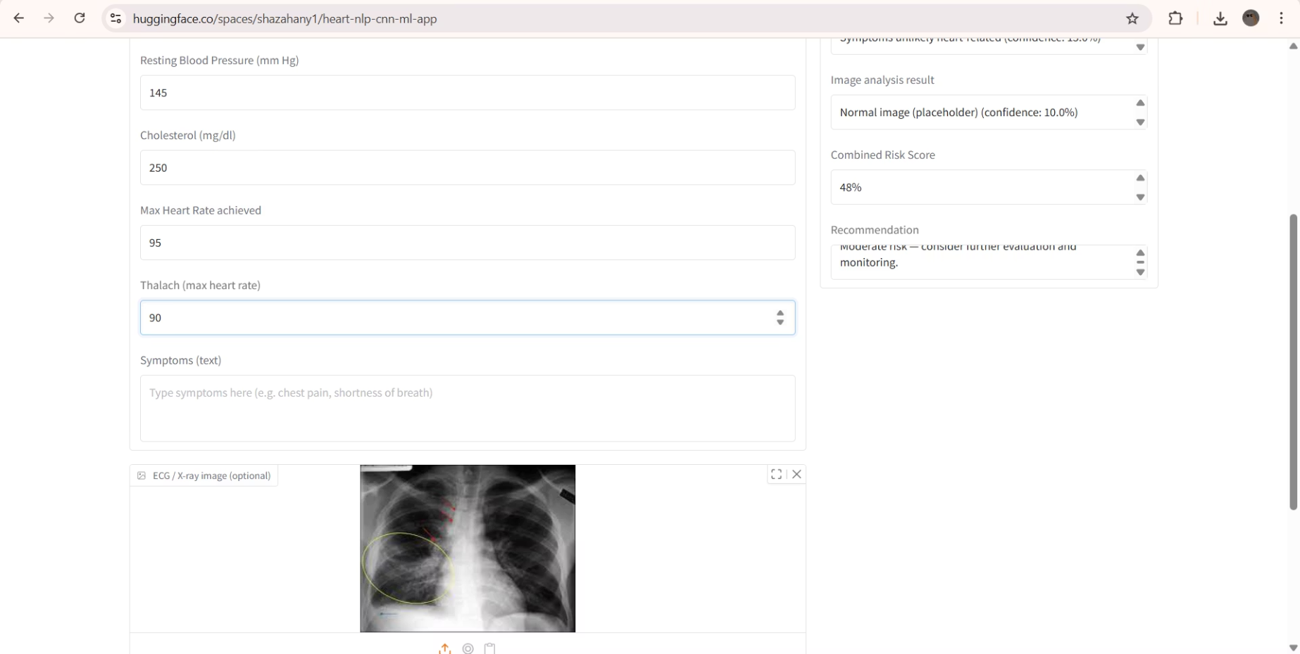
Module Deep Dive: Computer Vision (CNN) for Image Analysis
The CNN module provides visual confirmation of disease markers, often undetectable by the naked eye. This non-invasive diagnostic tool significantly enhances the system's overall reliability.
Data Types: ECG images (Arrhythmia detection) and potentially Chest X-rays (Cardiomegaly—heart enlargement).
Architecture: We will deploy a standard CNN architecture or leverage Transfer Learning with pre-trained models like ResNet or VGG to accelerate development and boost accuracy.
Advanced Techniques: Data augmentation will be applied to prevent overfitting on smaller datasets. Object Detection (optional phase) may be implemented to precisely localise anomalies (e.g., specific rhythm disturbances on an ECG trace).
We recommend starting with the smaller ECG Images Dataset for feasibility and later integrating Chest X-ray data if time and resources a

Slide 6
Core Project Deliverables
The combined output of the three AI modules generates a comprehensive, actionable report for the end-user.
76%
1
2-3
Risk Percentage
Integrated Diagnosis
Actionable Recommendations
A precise, aggregated probability score derived from the ML model, indicating the likelihood of having or developing heart disease.
A unified view combining tabular data, symptom analysis, and image interpretation into a single, cohesive result.
System-generated advice, such as "Recommend consulting a cardiologist for further diagnostic tests," based on the composite risk score.
The system doesn't just predict; it contextualises the risk, providing a critical tool for preliminary screening and patient triage.

Slide 7




Project Structure and Team Division of Labour
The project is modularly structured, allowing for parallel development and efficient integration. This distribution of responsibilities ensures that each specialised component is expertly handled.
Person 1: Data Management & ML Prediction
Tasks include data collection (UCI/Kaggle), EDA, model training (LR, RF, XGBoost), and exporting the optimal predictive model.
Person 2: NLP Symptom Analysis
Responsible for symptom dataset creation, text preprocessing, training and testing the NLP classification model to interpret free-text symptoms.
Person 3: Computer Vision & CNN
Focuses on sourcing medical images (ECG/X-ray), building/fine-tuning a CNN model, and implementing techniques like data augmentation and transfer learning for high-accuracy image diagnosis.
Person 4: Integration & Interface Design
The integrator role, focused on developing the unified dashboard (e.g., Streamlit), merging the outputs of the three models, and designing the final user report and visualisation.

Slide 8
Data Strategy and Resource Allocation
Selecting the right dataset size and type is crucial for efficient development, particularly when integrating different AI paradigms. We must balance complexity with project timelines.
ML Prediction (Person 1)
UCI Heart Disease (Tabular)
Small (~50 KB). Ideal for fast iteration and training standard ML models.
NLP Symptoms (Person 2)
Curated Symptom Set (Text)
Small (~200 KB). Custom data needed to specifically map cardiac symptoms to risk.
CNN Vision (Person 3)
ECG Images Dataset (Images)
Medium (~200 MB). Feasible size for early CNN training and quick model validation using Transfer Learning.
CNN Extension (Optional)
Chest X-ray Dataset (Images)
Larger (~1 GB). Requires more computational power and time; reserved for a later enhancement phase.
The current strategy focuses on using the smallest, most suitable datasets (UCI, Curated Symptoms, ECG Images) to rapidly establish a functional, integrated baseline system.

Slide 9








The Integrated System: A Multi-Modal Diagnostic Pipeline
The final stage involves the Person 4 integrating the three trained models into a single, cohesive pipeline. The goal is to move beyond siloed results to a unified assessment.
Input Collection
Parallel Processing
Patient provides tabular data, writes symptoms, and uploads medical images (ECG/X-ray).
ML, NLP, and CNN models execute simultaneously, generating three distinct feature sets/initial probabilities.
User Interface Report
Meta-Model Synthesis
The dashboard presents a holistic diagnosis, including risk scores, visualisations, and comprehensive medical recommendations.
A final, small meta-model (e.g., Logistic Regression) receives the outputs of the three sub-models and synthesises them into a single, refined risk score.
By combining the files/weights of the three models, the integration team can deploy an intelligent interface that offers a comprehensive view of patient health, detecting potential correlations between different diagnostic inputs.

